Slide 1
DISASTER RECOVERY WITH IBM CLOUD VIRTUAL SERVERS
Phase 4
Team Leader: S. Nandhini
Team Members:
M. Megalathangamani
D. Mavuriya
A. Devika
G. Kowsalya
G. Mounasakthi

Slide 2
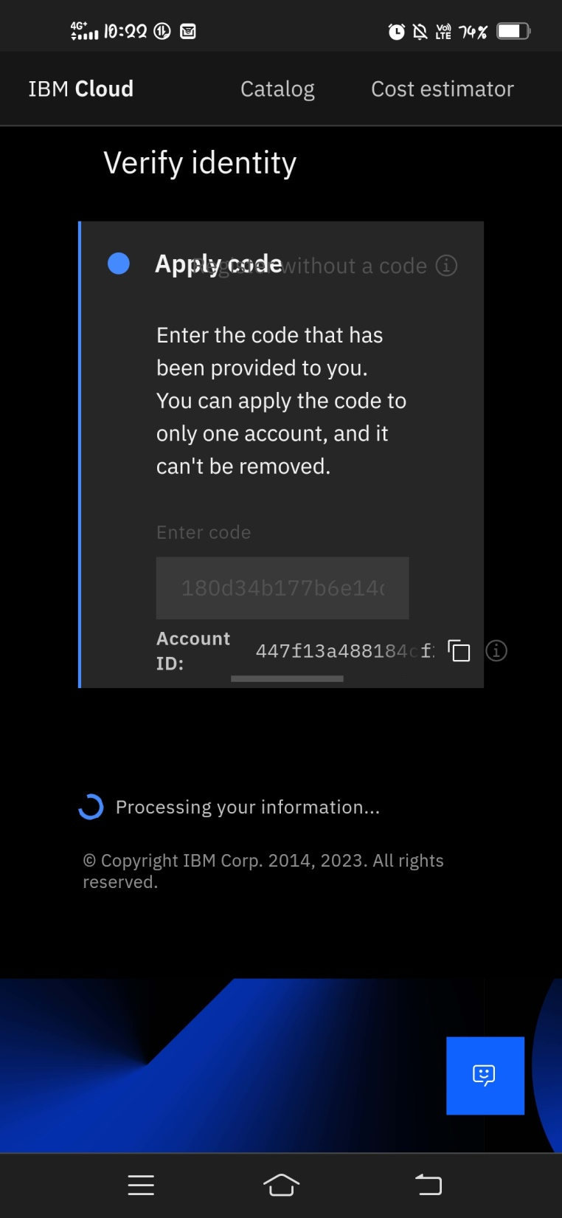
Step 1: Creating IBM cloud account.

Slide 3
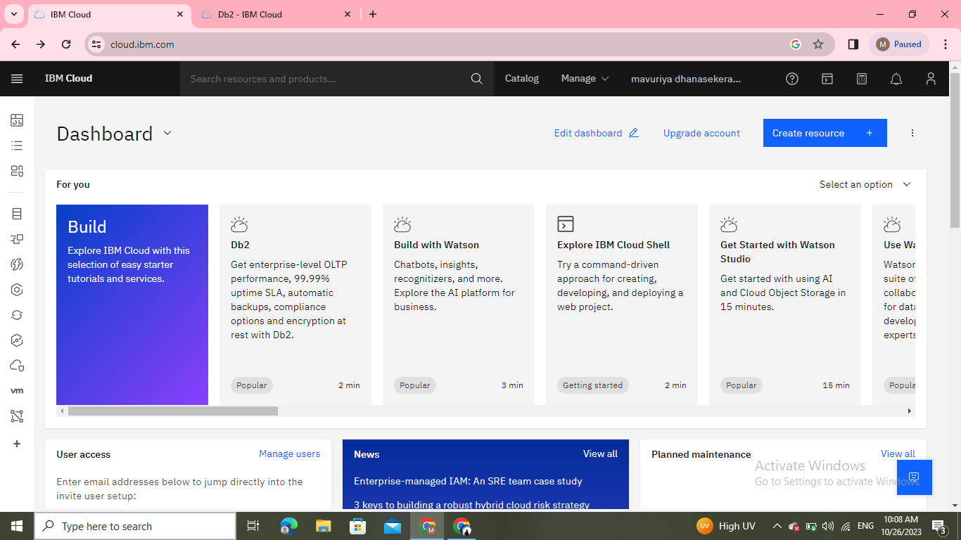
STEP 2: Create a resoure in Dashboard.

Slide 4
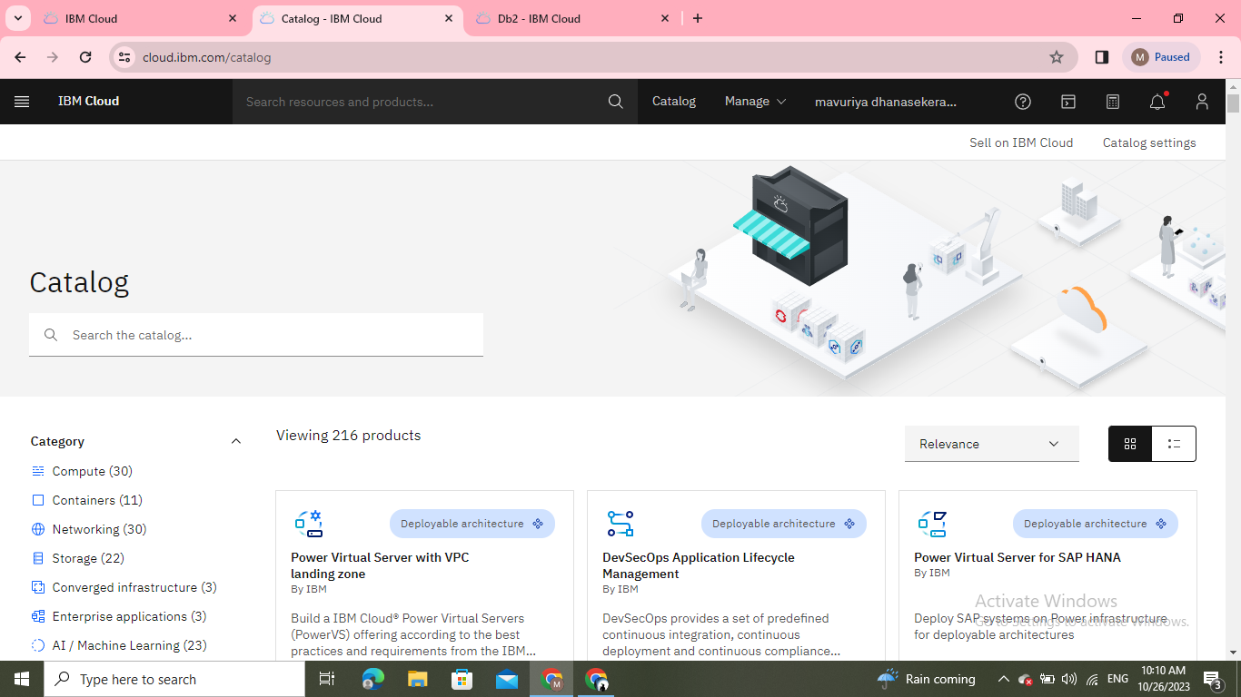
Step 3: Choose DB2 database:

Slide 5
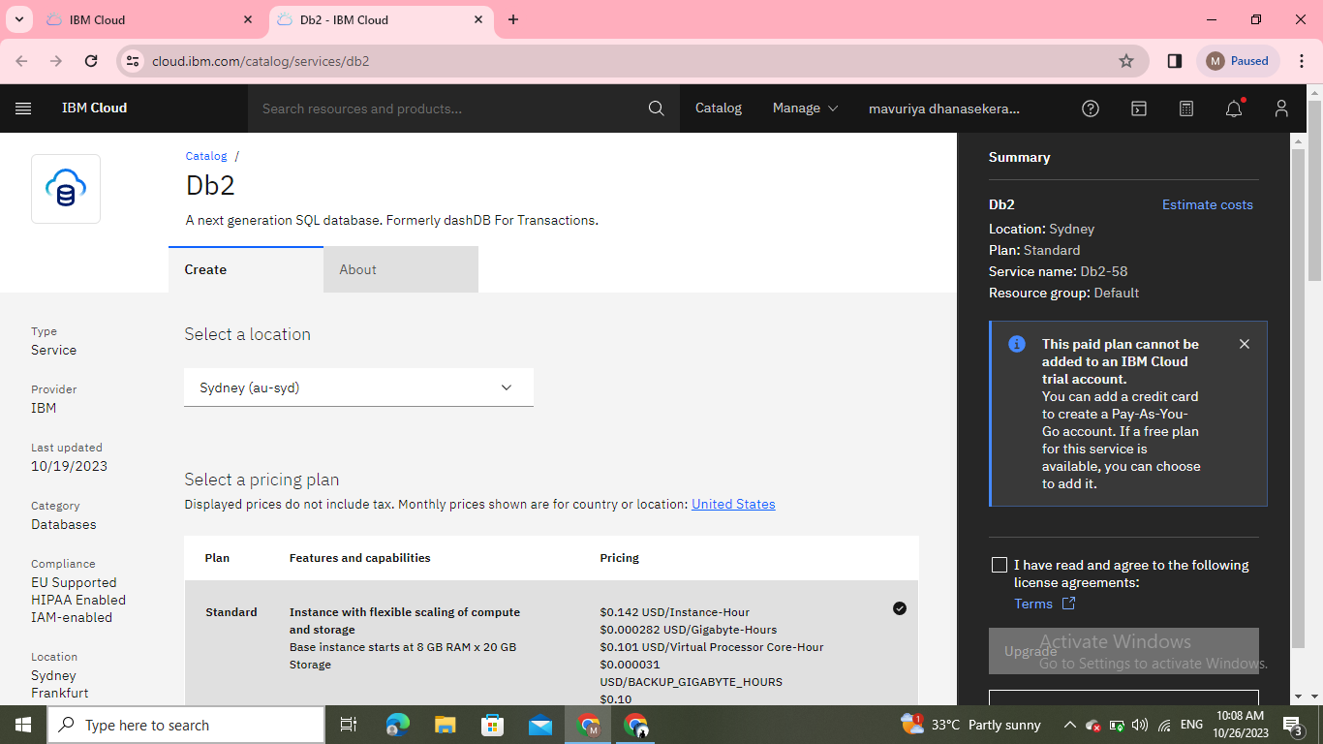
Step 3: Click the resource list to active the Db2.

Slide 6
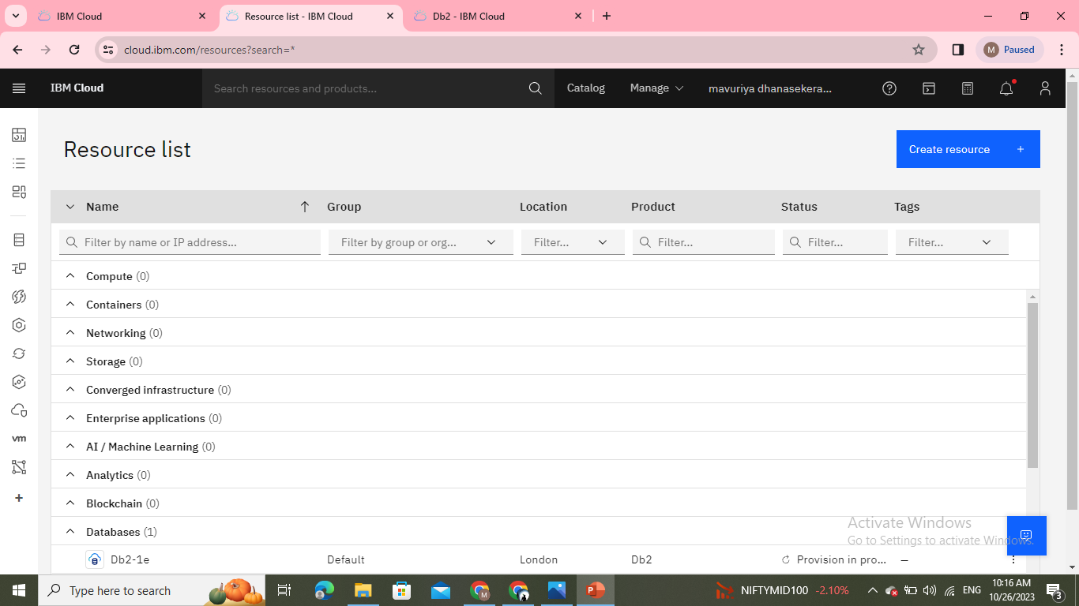
Step 5: Create the resource list to activate instance database.

Slide 7
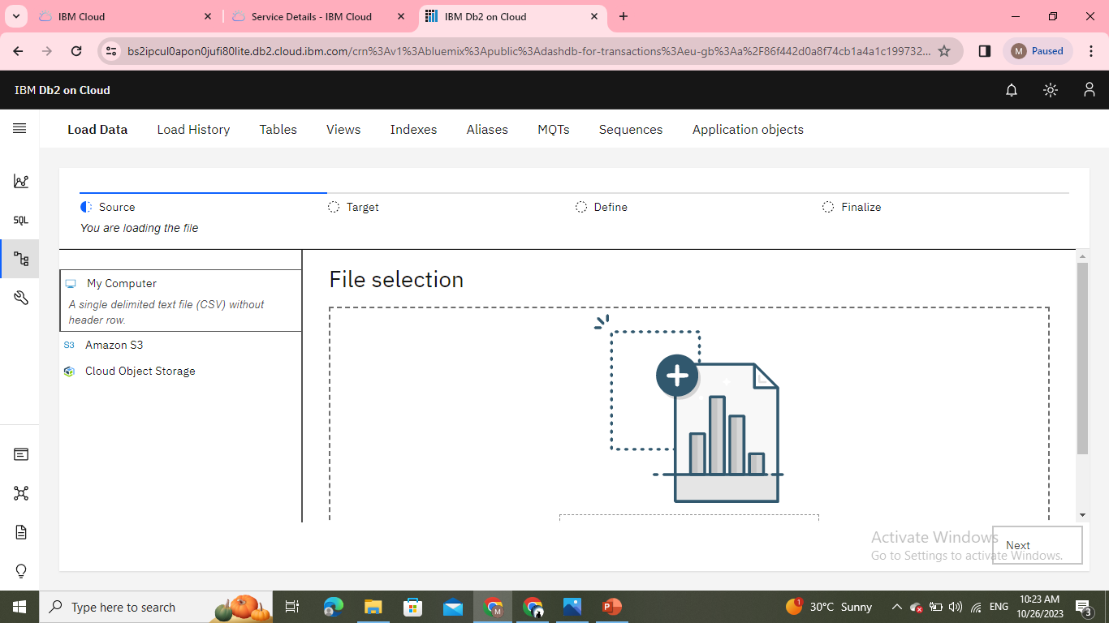
Step 6: Then drag a file.Select a dataset.

Slide 8
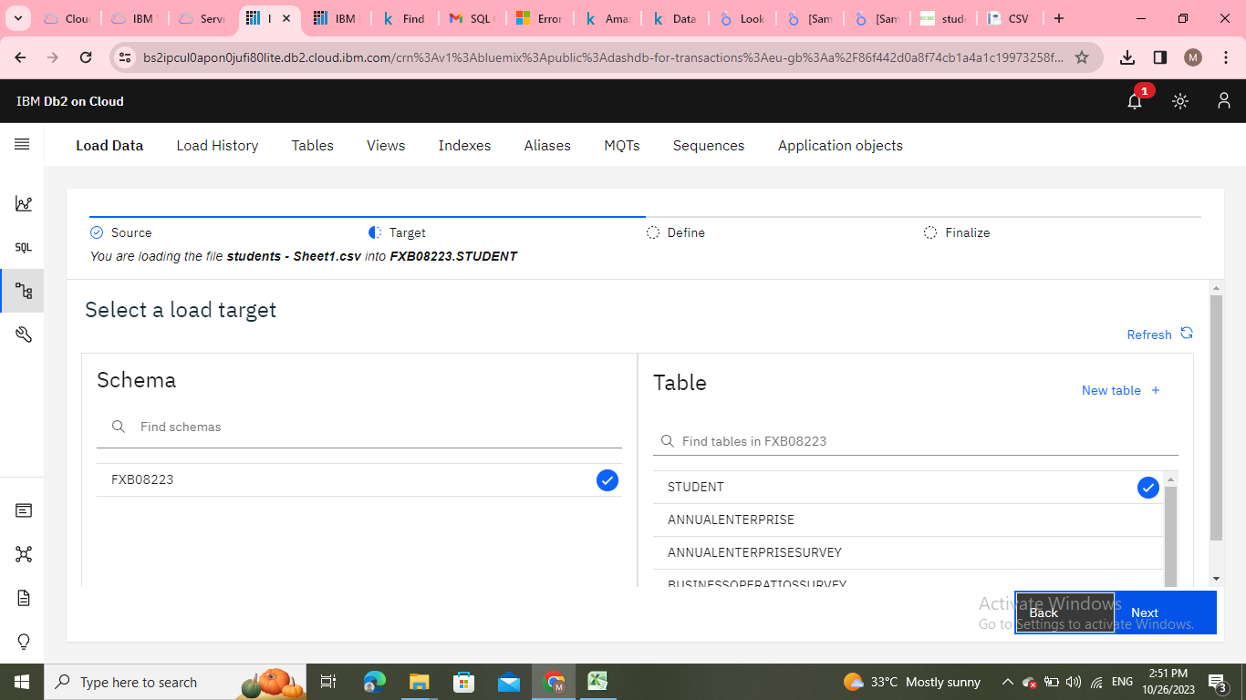
Step 7: I select the student dataset.

Slide 9
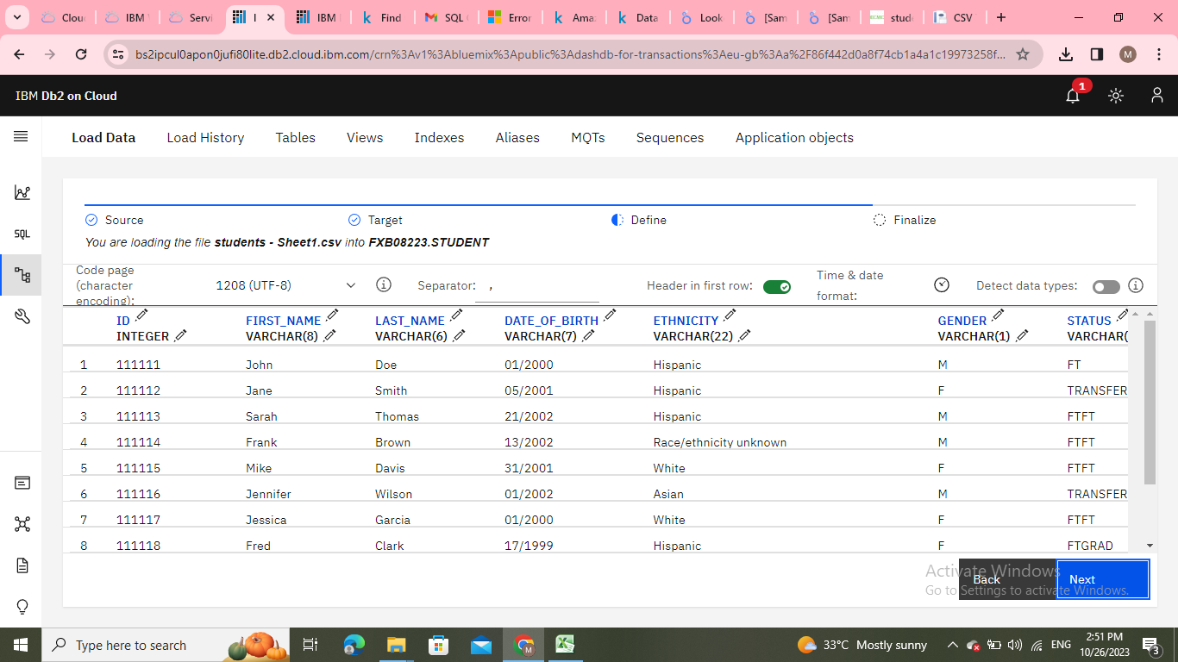
This is the dataset which I choosed

Slide 10
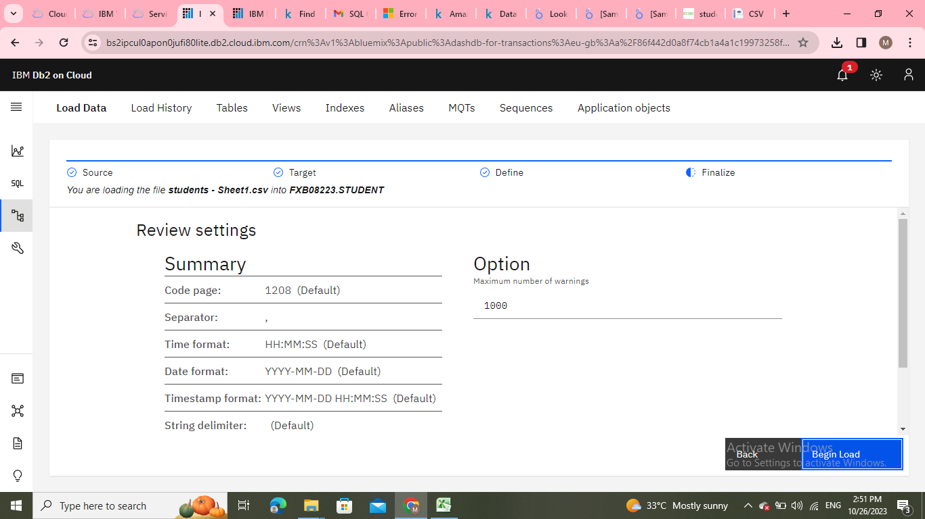
Step 8: Here the dataset were created in rows and cloumns formate then
click review settings.

Slide 11
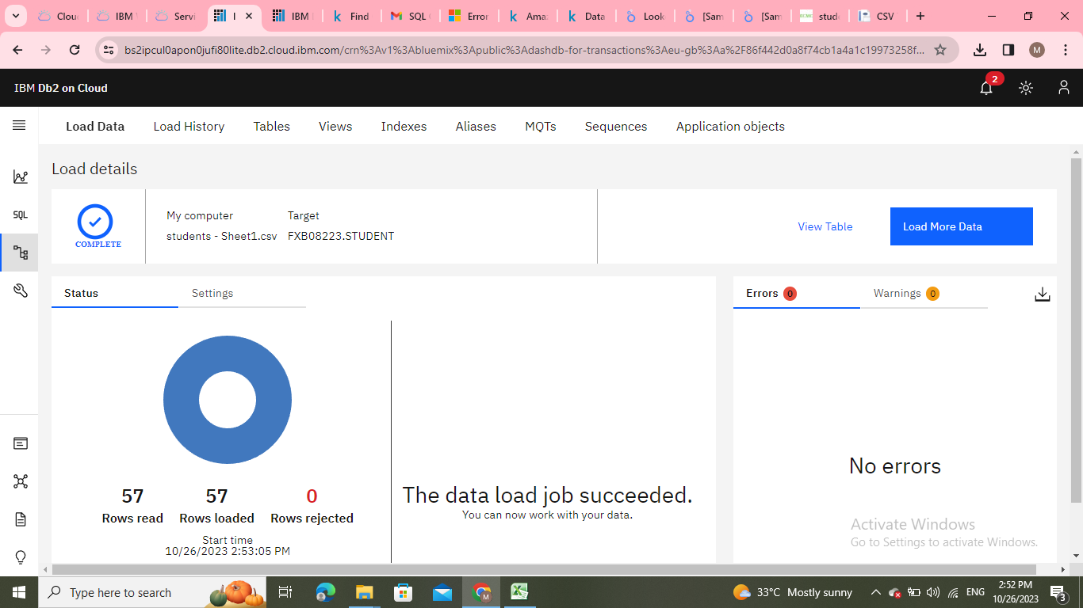
Step 9: Review settings

Slide 12
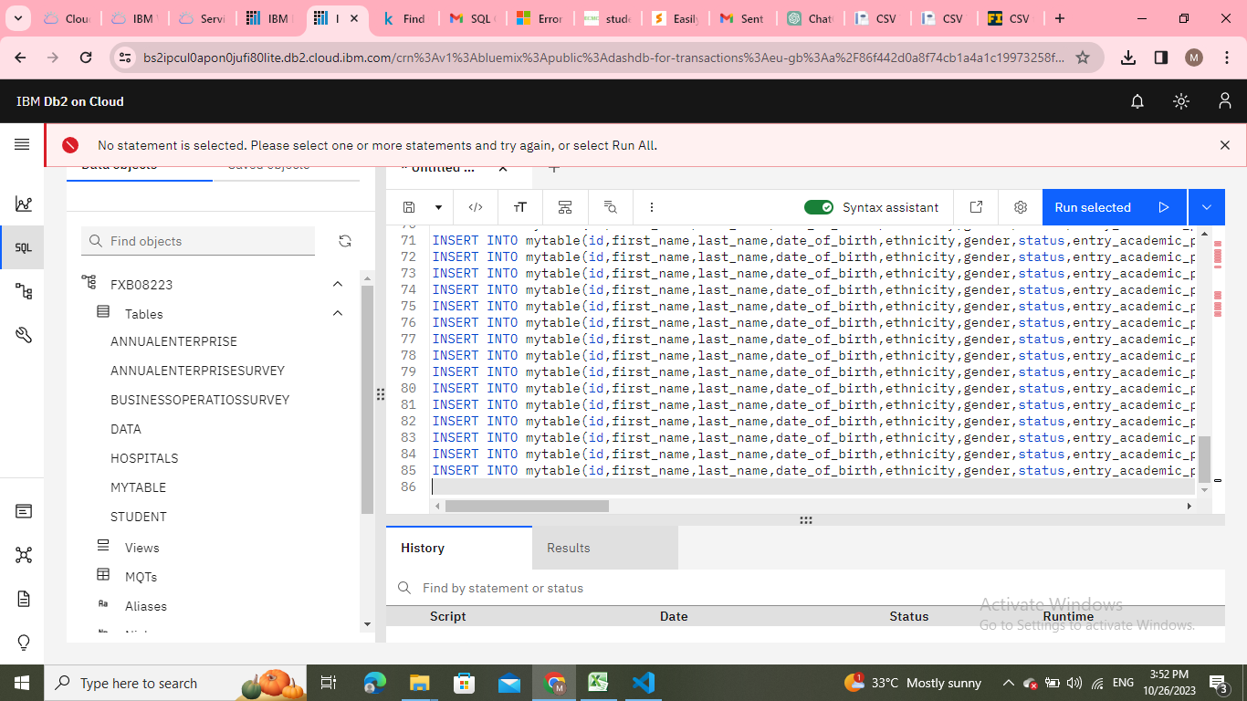
Step 9: Then select a SQL and select a student dataset and insert a SQL query.

Slide 13
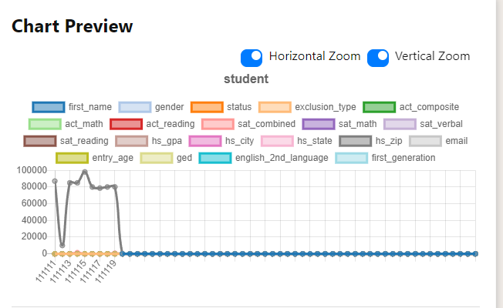
Step 10: This is the output for graphical representation of the dataset which
I choosed.

